Slide 1
WELCOME
TO OUR PRESENTATION

Slide 2

;;

Slide 3
Contents
Project Scope
Development Process
Testing and Quality Assurance
Support
Introduction
Agile Methodology
Progress Overview
Conclusion

Slide 4
Introduction
Personalized learning is a way of teaching that tailors education to each student's individual needs, interests, and abilities. It is different from traditional teaching, where all students are taught the same thing in the same way. In personalized learning, teachers use technology and other tools to track each student's progress and identify their strengths and weaknesses. They then adjust the curriculum and teaching methods to help each student learn at their own pace and in a way that is most effective for them.This approach can help students learn more effectively and efficiently, and it can also help them develop a love of learning.

Slide 5
GLIMPSES OF STUDY-TECH
Study Tech is an app designed to help you learn more effectively. It uses a personalized approach that tailors the learning experience to your individual needs. This means that the app will adjust the difficulty and pace of the content based on your progress.

Slide 6
PROJECT SCOPE
Personalized Learning Paths:
Create a system that can generate individualized learning paths based on user preferences, goals, and progress.
Progress Tracking and Analytics:
Implement features to track user progress, provide detailed analytics, and offer insights for improvement.
Teacher or Tutor Support:
If applicable, consider providing options for connecting users with teachers or tutors for additional assistance.
Goal Setting and Achievement:
Allow users to set personalized learning goals and provide tools to track progress and celebrate achievements.

Slide 7
AGILE METHODOLOGIES
Agile methodologies are a way of working that helps teams create software quickly and efficiently. They break down projects into smaller parts and work on them one by one. This makes it easier to change things if needed and get feedback from users early on. For a personalized learning app like Study Tech, Agile methods can be very helpful. They can help the team:
Work faster: By breaking down the project into smaller parts, the team can work on different things at the same time and get things done faster.
Be more flexible: If something changes, the team can easily adjust the plan and keep moving forward.
Get feedback early: By showing users the app as it's being built, the team can get feedback and make sure it's what users want.
Deliver things faster: The team can release new features and updates more often, so users can start using them sooner.

Slide 8
DEVELOPMENT PROCESS
Study Tech: A Personalized Learning Companion Study Tech is a cutting-edge app designed to revolutionize the way students learn. It offers a personalized approach that tailors the learning experience to each individual's needs, interests, and pace.
Key Features:
*Adaptive Quizzes: Study Tech generates quizzes that are dynamically adjusted based on a student's performance. This ensures that students are always challenged but not overwhelmed.
* Personalized Learning Paths: The app creates customized learning paths based on a student's goals, strengths, and weaknesses. This helps students focus on areas where they need the most improvement.
* Interactive Content: Engaging multimedia content, such as videos, animations, and interactive simulations, makes learning more fun and effective.
*Progress Tracking: Students can easily monitor their progress and identify areas where they need to focus.
* Real-time Feedback: Study Tech provides instant feedback on quizzes, helping students understand their mistakes and learn from them.How Study Tech Helps Students Learn * Identifies Knowledge Gaps: By analyzing a student's performance on quizzes, Study Tech pinpoints areas where they need more support.

Slide 9
Tailors Content: The app adjusts the difficulty and pace of the content to match the student's abilities.
Provides Targeted Practice: Study Tech offers targeted practice exercises to help students reinforce their understanding.
Offers Feedback and Guidance: The app provides real-time feedback and guidance to help students overcome challenges. With Study Tech, students can take control of their learning journey and achieve their academic goals more effectively.

Slide 10
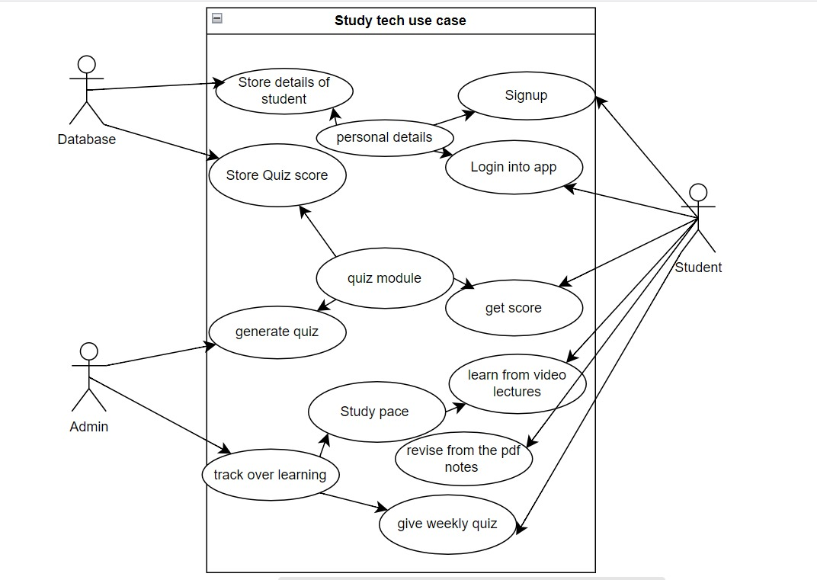

Slide 11
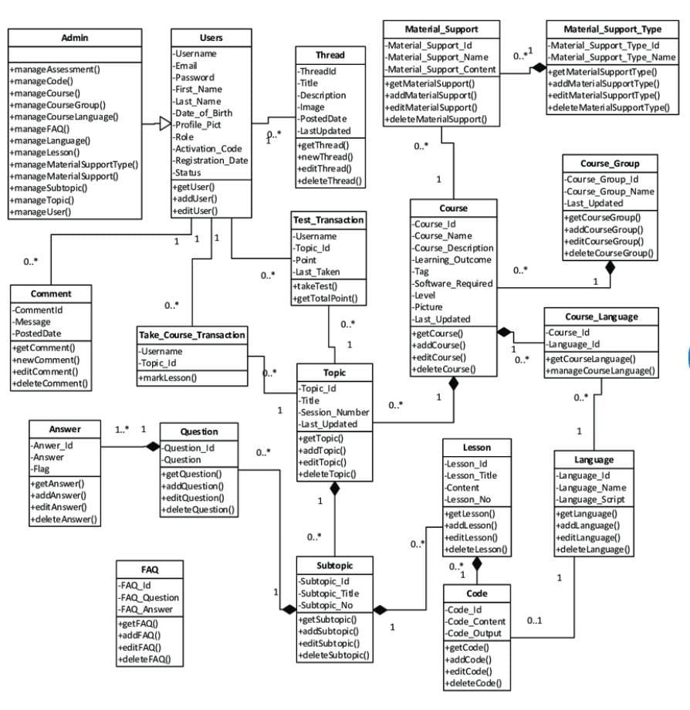

Slide 12
PROGRESS OVERVIEW
Progress Overview for Study Tech. To provide a comprehensive progress overview for the Study Tech project, I would need more specific information about the project's current status, goals, and milestones. However, based on the discussions we've had, here's a general outline of potential areas to focus on:
Project Goals and Objectives
* Alignment: Are the current goals and objectives still aligned with the overall vision for Study Tech?
Progress: Have we made significant progress towards achieving these goals?
Adjustments: Are there any necessary adjustments to the goals or objectives Key Milestones and Deadlines

Slide 13
Achievement: Have we met the key milestones and deadlines set for the project? * Delays: Are there any areas where the project is behind schedule?
Adjustments: Are there any adjustments needed to the timeline?Feature Development and Implementation Completion: Which features have been fully implemented
Progress: What is the status of ongoing feature development
Quality: Are the implemented features meeting the desired quality standards Testing and Quality Assurance
Thoroughness: Have we conducted comprehensive testing to identify and address issues
Quality: Are we ensuring the app's overall quality and reliability
Improvements: Are there any areas where we can enhance our testing processes User Feedback and Adoption
Collection: Have we gathered feedback from users?
Analysis: Are we analyzing user feedback to identify areas for improvement

Slide 14
TESTING AND QUALITY ASSURANCE
Testing Study Tech involves ensuring its functionality, usability, performance, compatibility, security, and accessibility. This includes:
Functional testing: Verifying core features work as expected.
Usability testing: Evaluating ease of use and navigation.
Performance testing: Assessing speed and responsiveness.
Compatibility testing: Ensuring it works on different devices and browsers.
Security testing: Protecting user data and preventing vulnerabilities.
Accessibility testing: Making it usable for people with disabilities.

Slide 15
CONCLUSION
Study Tech is a powerful personalized learning tool that can help students achieve their academic goals. By leveraging adaptive quizzes, personalized learning paths, interactive content, and real-time feedback, Study Tech provides a tailored and engaging learning Experience. Through rigorous testing and quality assurance, Study Tech can be developed into a reliable and effective tool that benefits students of all ages and backgrounds. By continuously improving and adapting to the evolving needs of learners, Study Tech can become an indispensable resource for education.

